Slide 1

SQUANDER
SPRING 2022 CAPSTONE PROJECT | PROF HENRY WONG
Aakansha Agarwala
Austin Blaise
Rajat Nagavkar
Suryadeep Nallana
Nicholas Wong

Slide 2
AGENDA
Project Description
Retrospective
Technologies
Sprint Schedules
Market Analysis
Personas

Slide 3
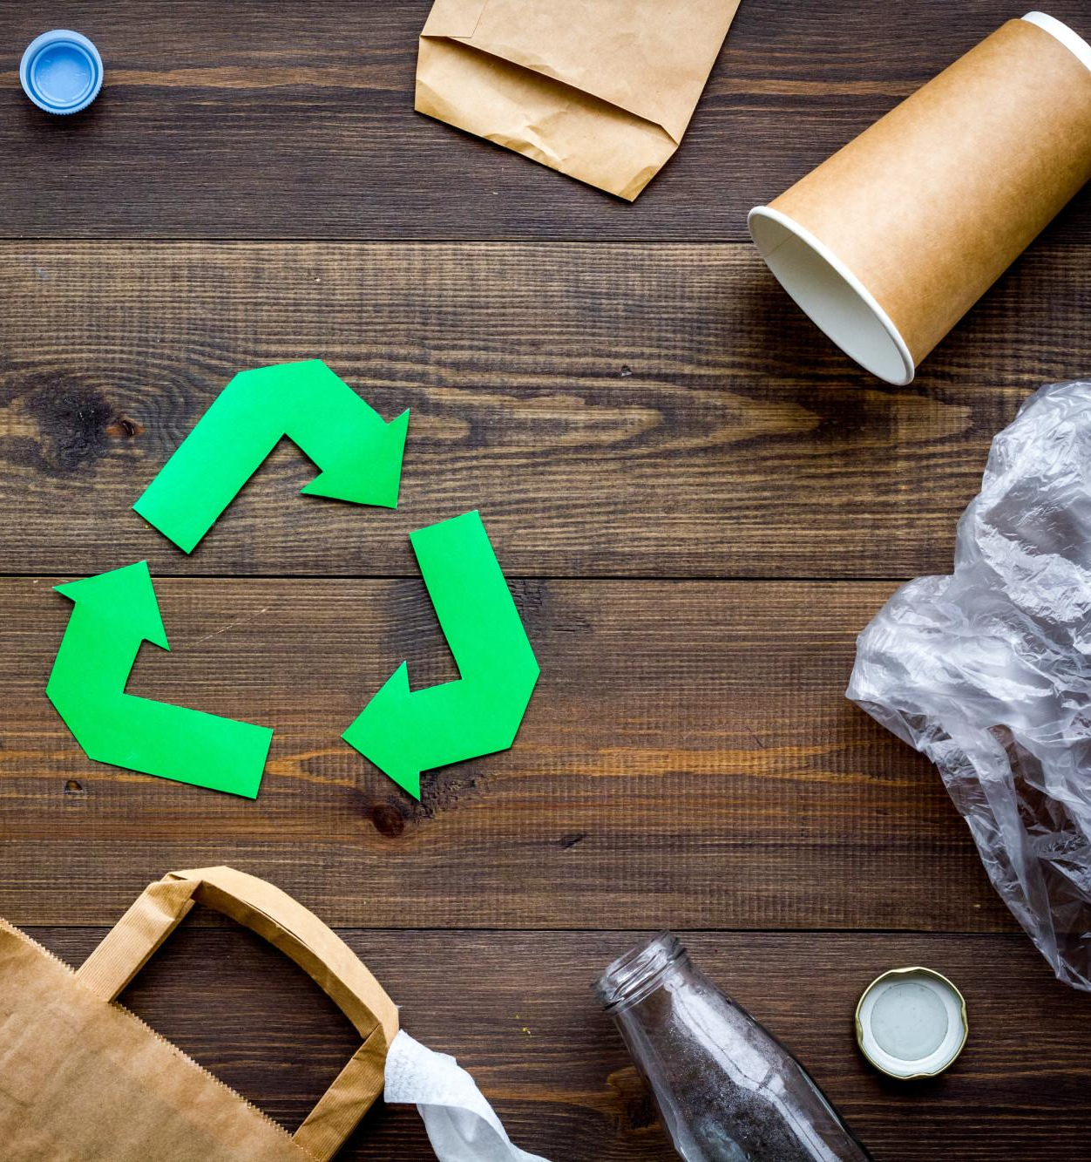
PROJECT
DESCRIPTION

Slide 4
PROJECT DESCRIPTION
Squander is an application that allows users to manage waste by analyzing images to categorize types of waste and to plan waste management accordingly.
The goal of this project is to make it easier to recycle waste after any kind of event or project.

Slide 5




TECHNOLOGIES

Slide 6

MARKET ANALYSIS

Slide 7
AppName | Platform | Image Recognition | Function
Squander | Web and Mobile Application | Yes | Uses Image recognition to detect waste and allows user to find proper recycling plants and schedule pickup.
RecycleNation | Web and Mobile Application | No | Can locate recycling centers on map, tracks user contribution to recycling movement.
WhatGoesWhere | Web and Mobile Application | No | Guides user for curbside program and drop-off location to maximize recycling.
WM | Web and Mobile Application | No | Allows pickup Service for residential, business waste by prior scheduling.

Slide 8

PERSONAS
Notes:
Nick

Slide 9

Simon : Manager at discreteWaste.co
Simon is the manager at discreteWaste company. He is responsible for creating an efficient system that could segregate the waste into categories that could improve the value generated from the waste segregation and reduce the cost of disposal.

Slide 10
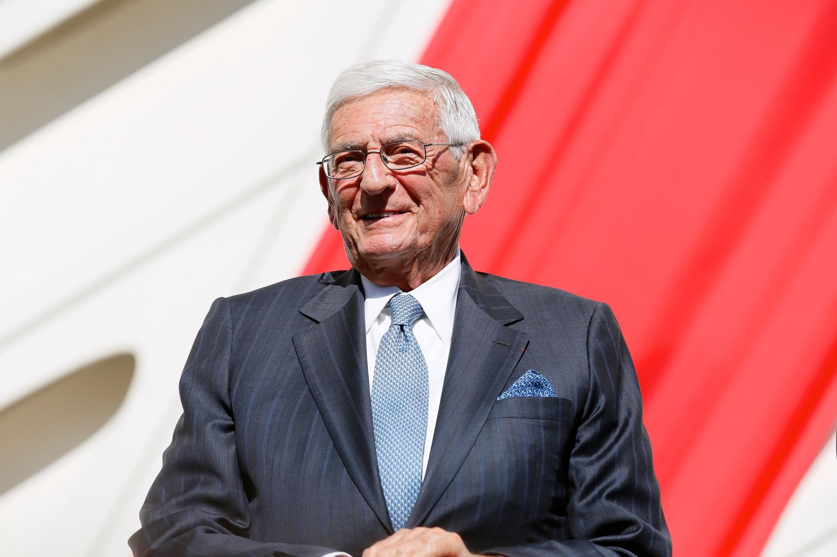
Jill: Environment Philantropist
Jill is rich business man, he wants his money to make an impact of the world for his grandchildren. His passion is on improving how we manage the waste and wants to invest money on waste segregation tools and improve recycling.

Slide 11
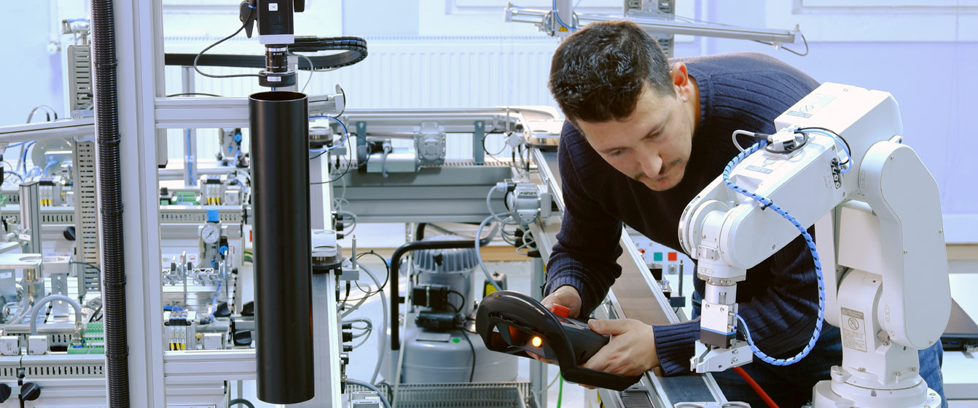
Mark : Engineer
Mark works at the segregation engineering team and want a system to analyse the efficiency of the current segregation system. He also wants to keep the quality of the process high even during the automated phase of the system.

Slide 12

SPRINT SCHEDULE
Notes:
Nick

Slide 13
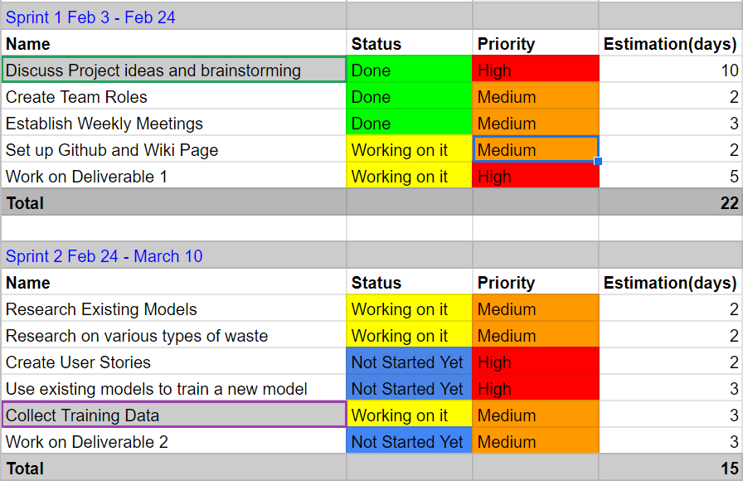
Notes:
Looking at previous groups we chose to go with a similar timeline, in Sprint one we chose our topic and researched the potential impact our project can have on waste management. We also created team infrastructure, with team roles and meet up times. Lastly we created a home for our project with a Github repository. Moving on to sprint two we will start getting into more specialized research, looking into existing models, researching different kinds of waste and their appropriate collection services, looking for more training examples. Pretty much most of our preprocessing of data will be done in sprint 2

Slide 14
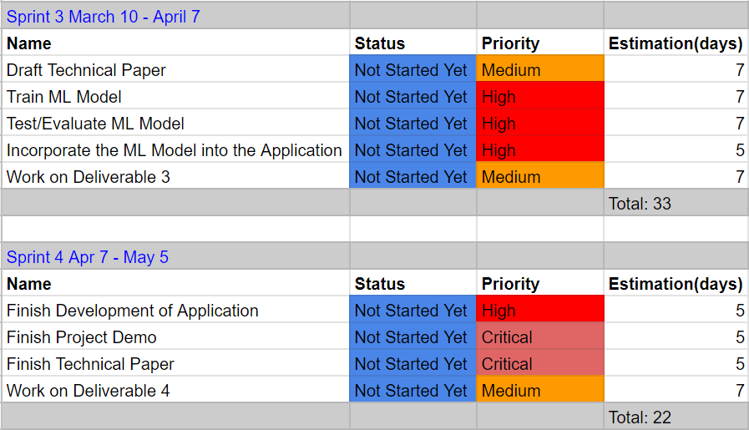
Notes:
Moving on to sprint three we will begin drafting our technical paper and start working on the more technical aspects of our project. We will be training and evaluating the model with the data we collected in sprint 2. And we will also be incorporating the model into our application. Lastly in our final sprint we will be looking to wrap up the technical aspects of the project, the technical paper, and finalizing our MVP, minimum viable product to show to the class.

Slide 15

RETROSPECTIVE

Slide 16
WHAT WENT WELL
We did well collecting useful and relevant background information for the project
We have done a good job defining goals and agendas before having meetings

Slide 17
WHAT NEEDS IMPROVEMENT
Creating a consistent meeting time to better coordinate parallel workflows in the team.
Work on more ways to consolidate the information we collect individually.

Slide 18
FUTURE STEPS
Keeping track of various task and proper time scheduling.

Slide 19
CONCLUSION

